Slide 1

PRESENTATION TITLE:
Intelligent Multi-Disaster Alert System
Presented by: Naila Shehzadi
Department of Computer Engineering

Slide 2


Problem Statement
Global Impact
Current Limitations
The Need
Natural disasters cause serious damage and loss of human lives worldwide.
Most existing alert systems do not support multiple disasters and lack real-time priority alerts.
There is a need for a smart, hardware-based system that can detect disasters, prioritize them, and send alerts quickly.

Slide 3

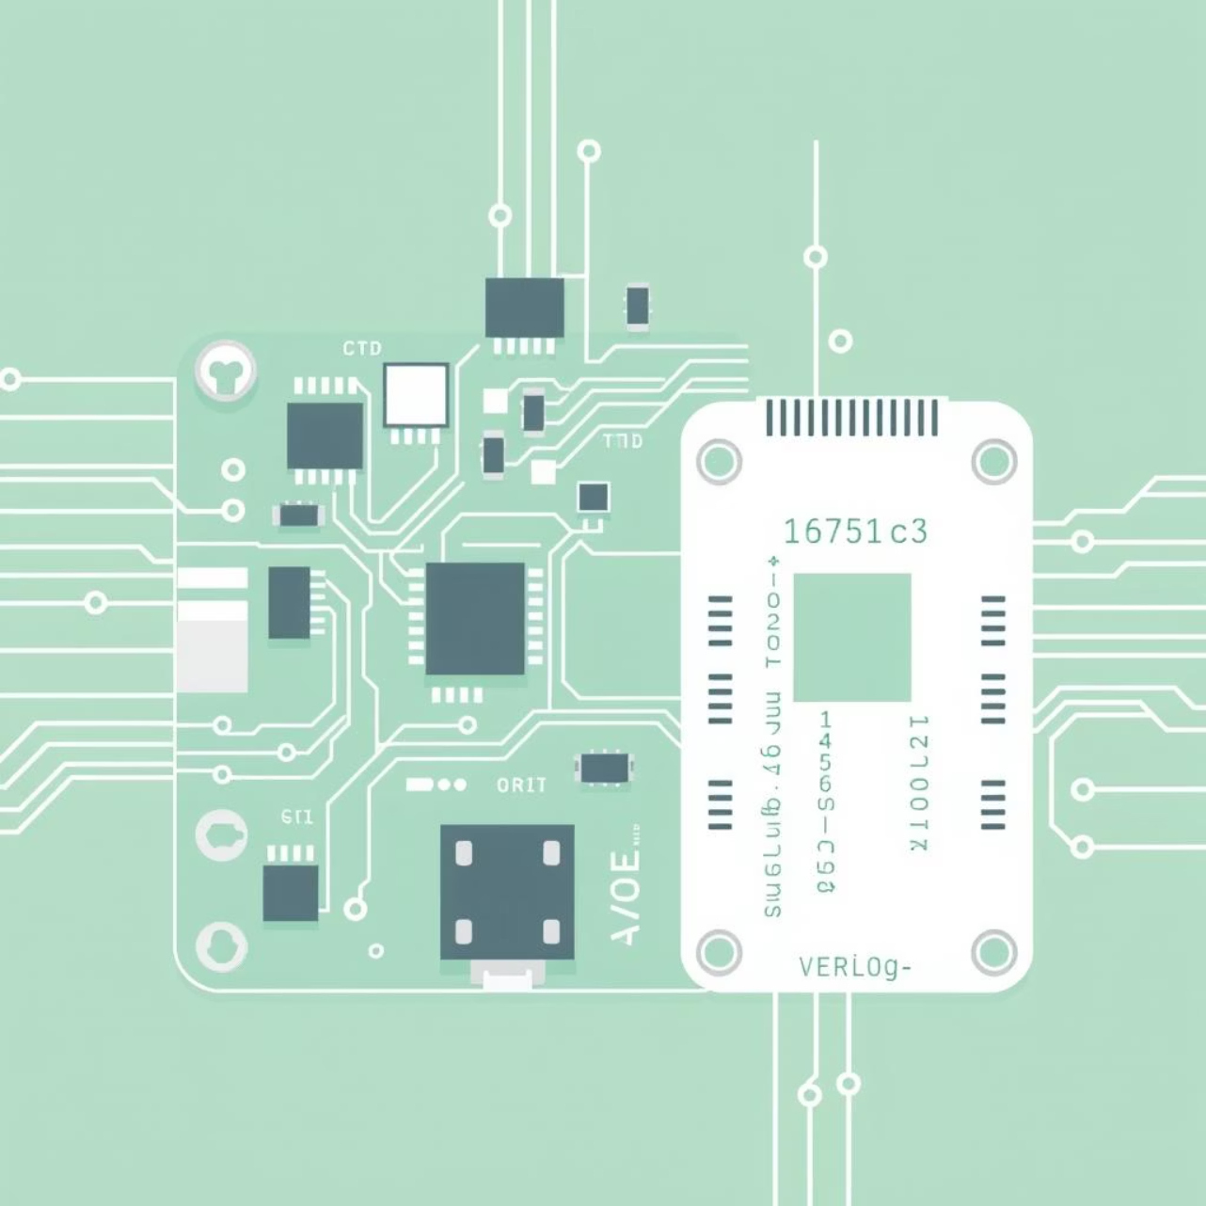
Project Introduction
IoT-Enabled Design
Integrated Sensor Inputs
An IoT-based multi-disaster alert system developed using Verilog.
Uses multiple sensors to detect earthquakes, floods, fires, and storms.
FPGA Logic for Speed
FPGA logic provides fast decision-making and quick alert generation.

Slide 4

Objectives
01
02
Sensor Data Simulation
Decision Logic Implementation
Simulate sensor data and compare it with set threshold values.
Use logic to decide and prioritize alerts based on severity.
03
04
Priority Encoder Development
UART Communication
Select the most important disaster alert.
Send alerts quickly using UART communication.

Slide 5

System Overview
Multi-Sensor Input
1
Gets data from sensors (earthquake, temperature, humidity, pressure).
Threshold Comparison
2
Checks if the readings are safe.
Decision Logic Module
3
Looks at all data to see if any disaster is happening.
Priority Encoder
4
Picks the most serious alert.
UART Transmission
5
Sends it to devices or monitors.

Slide 6



Software & Tools Used
Verilog HDL
ModelSim
Used to describe, design, and test all system parts.
Helps simulate functions and check waveforms of Verilog code.

Slide 7
Overall Methodology
Alert Transmission
1
Sends alert data to monitoring systems via UART.
Priority Selection
2
Priority encoder picks the most serious alert.
Disaster Detection
3
Logic checks combined sensor data to find active disasters.
Anomaly Detection
4
Compares sensor readings with set limits to spot problems.
Sensor Signal Simulation
5
Simulates sensor signals for different disasters.

Slide 8

Sensor Simulation & Threshold Comparison
The system simulates sensor data for different disasters and turns it into digital signals.
Threshold comparators check the signals for safety limits.
Earthquake Intensity: Seismic sensors measure ground movement.
Temperature: Detects fire from high heat.
Humidity: Detects floods from excess moisture.
Pressure: Detects storms from big pressure changes.
Comparators flag any unsafe readings for early warning.

Slide 9





Decision Logic Module & Priority Encoder
Combined Sensor Flags
The Decision Logic checks all sensor flags to see which disasters are happening.
Dynamic Priority Assignment
A Priority Encoder ranks alerts by importance (e.g., Earthquake > Fire > Flood > Storm).
Focused Alerting
Only the most important alert is sent, avoiding confusion.
Real-Time Responsiveness
Hardware-based decisions allow very fast responses for disaster management.

Slide 10

Multi-Disaster Alert System ASM Chart:

Slide 11


Working Principle of the System
The Intelligent Multi-Disaster Alert System operates on a sophisticated, yet straightforward, principle, ensuring timely detection and notification of potential threats.
Continuous Monitoring
Real-time Processing
Sensors monitor vibration, gas, water, and flames continuously.
Microcontroller checks sensor data against safety limits in real-time.
Instant Alert Trigger
Dissemination via UART
If readings are unsafe, an alert is triggered immediately.
Alerts are sent quickly via UART to different communication devices.

Slide 12
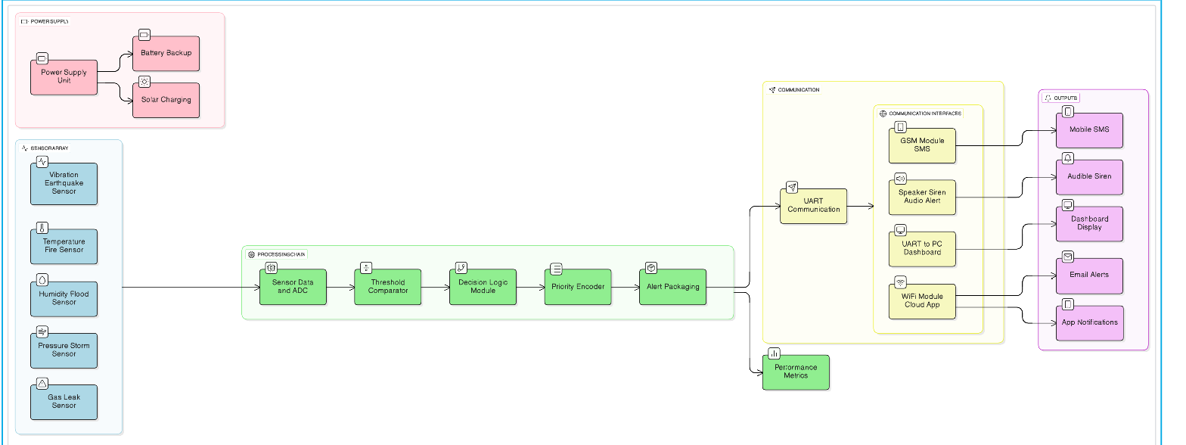
System Block Diagram
This comprehensive block diagram illustrates the interconnected components that form the backbone of the Intelligent Multi-Disaster Alert System.

Slide 13
Conclusion & Applications
The Intelligent Multi-Disaster Alert System is a big step forward in disaster management, providing protection and peace of mind.
1
Rapid & Reliable Warnings
Gives fast and dependable alerts for earthquakes, fires, floods, and gas leaks.
2
High-Performance Design
Uses a Verilog-based system for fast processing and easy integration with IoT devices.
3
Future-Proof Enhancements
Plans include AI-based predictions, edge computing without the cloud, and multi-language alerts for wider use.
Impact
This system can save lives and reduce the effects of disasters worldwide.

